Slide 1
Loksabha Election Analysis- 2019
Presented By:
Akhil Varghese

Slide 2
Import Libraries
Import Libraries Such as numpy, pandas, matplotlib and seaborn
These libraries are used for specifying data types,data analysis,data visualization and making statistical graphs.

Slide 3
Import dataset to python environment
Import election dataset by importing the .csv file.

Slide 4
Do necessary data describing methods.
Use head(),shape(),info(),describe() and corr() methods.
Head()-Displays the data.
Shape()-Defines shape of the dataset.
Info()-Shows information of all columns.
Describe()-gives overall data description
Corr()-shows correlation between the data
Use isnull() to check if there is any null values present in the dataset

Slide 5
Check null values and replace ‘not available’ with ‘0’
Use value_counts() method to check the values count
Use replace() for replacing ‘not available’ with ‘0’

Slide 6
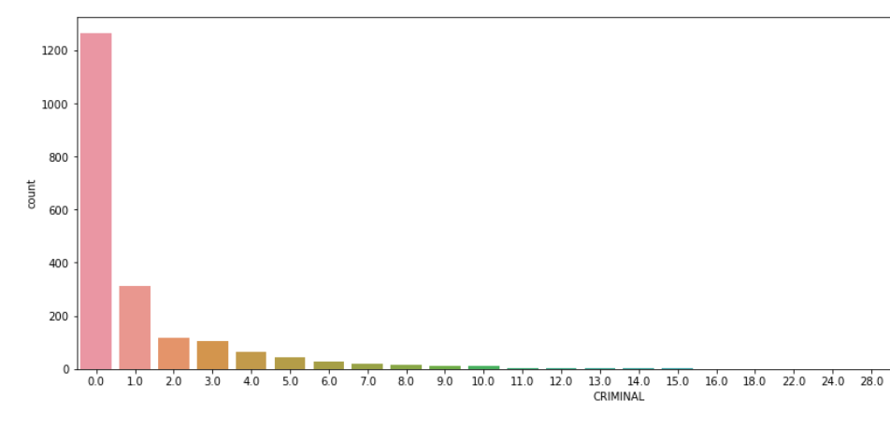
Plotting Bar chart to find crime rate in different states
Based on the provided description, it is apparent that the contestants have an average crime rate of 1.45, while the 25th and 50th percentiles have a minimum crime rate.
Although the contestants did not commit any crimes, it is disheartening that 75% of all candidates have a crime rate of 1.0. Additionally, it is noteworthy that the highest crime rate among an individual is 240, which is exceptionally high.

Slide 7
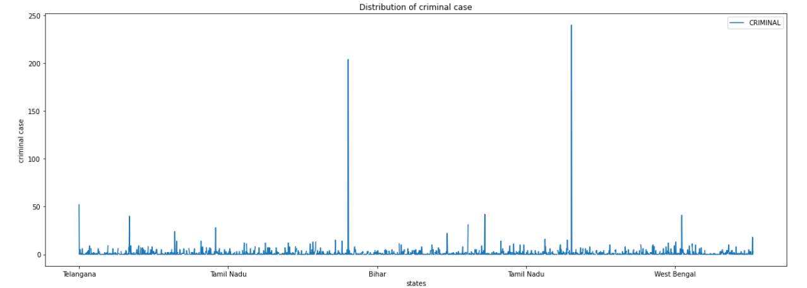
Plotting line graph to find which state has highest criminal case
Based on the provided graph and accompanying description, it is evident that one individual has committed the maximum number of crimes, with a total of 240 offenses.

Slide 8
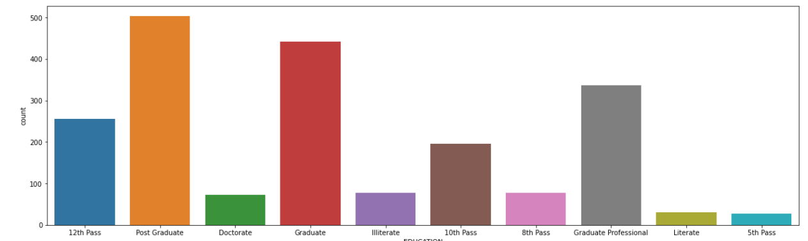
Plotting educational qualification count graph
To establish literacy as the minimum qualification is x. So, the columns for Class 8 and 5 pass should be merged. This would require categorizing all candidates who passed Class 5 or 8 as illiterate.

Slide 9
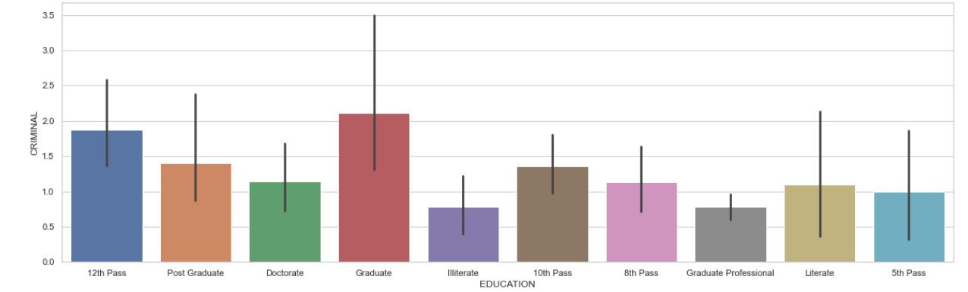
Educational vs. Criminal Bar plot
The majority of criminal candidates have either graduated or passed their 12th standard. It is worth noting that a particular individual with a graduate degree has committed 240 crimes.

Slide 10
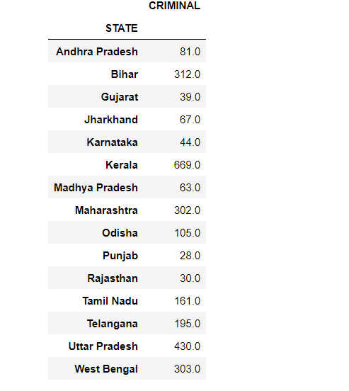
State wise candidates with crime case

Slide 11
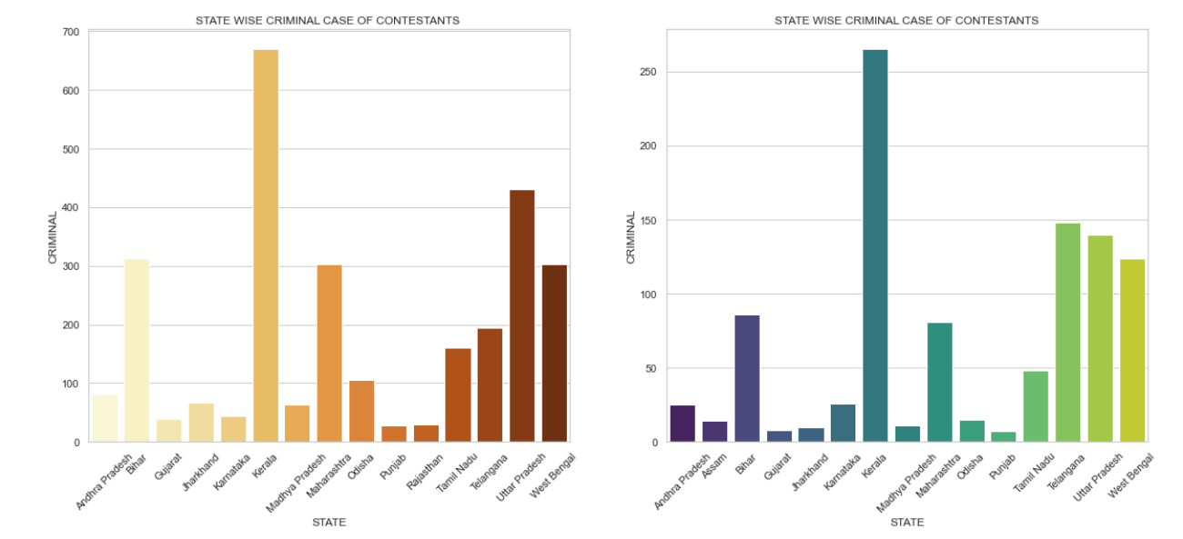
Bar plotting state wise crime cases
The graph displays crime cases across states for both candidates and winners. Notably, the state of Kerala has the highest bar on the graph, indicating the highest number of crime cases in that region.

Slide 12
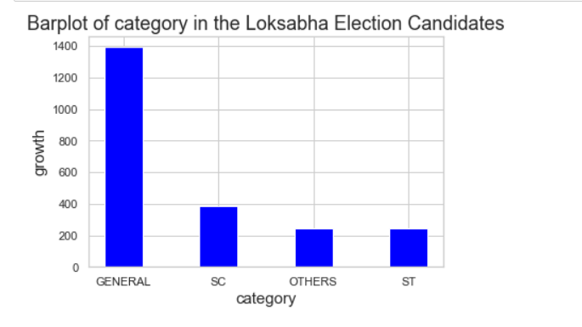
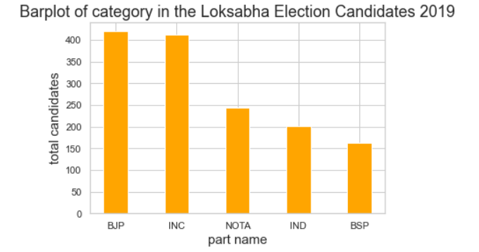
Bar plot category of growth

Slide 13
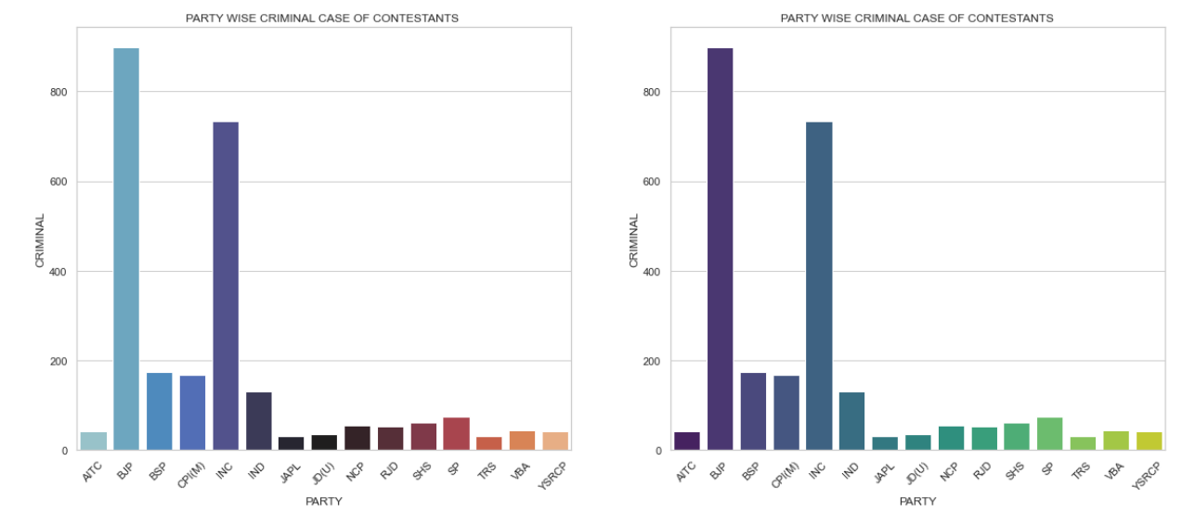
Bar plot of party vs. candidates with crime case
According to the graph, the BJP and Congress parties have the highest number of criminal cases in India. It is worth noting that these two parties have a nationwide presence, whereas most other parties are regional in nature.

Slide 14
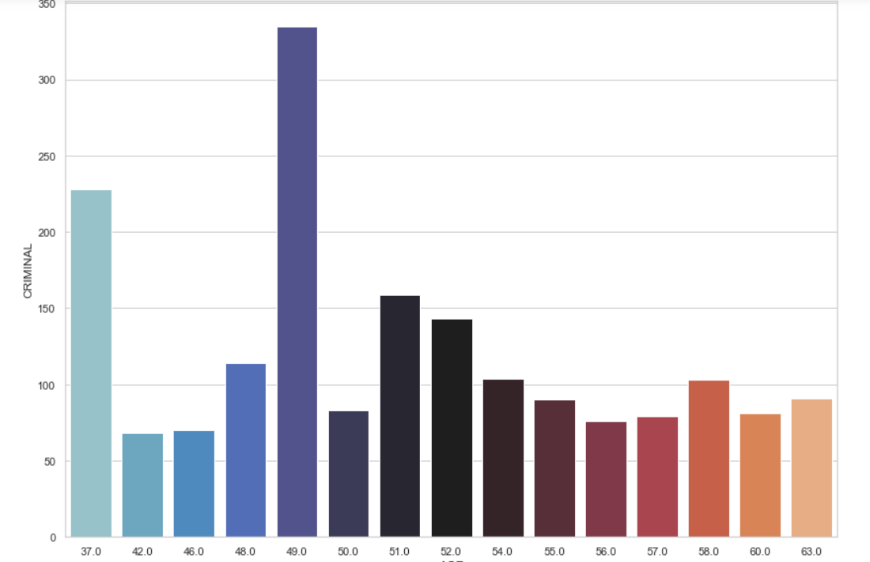
Bar plot of criminal vs. age

Slide 15
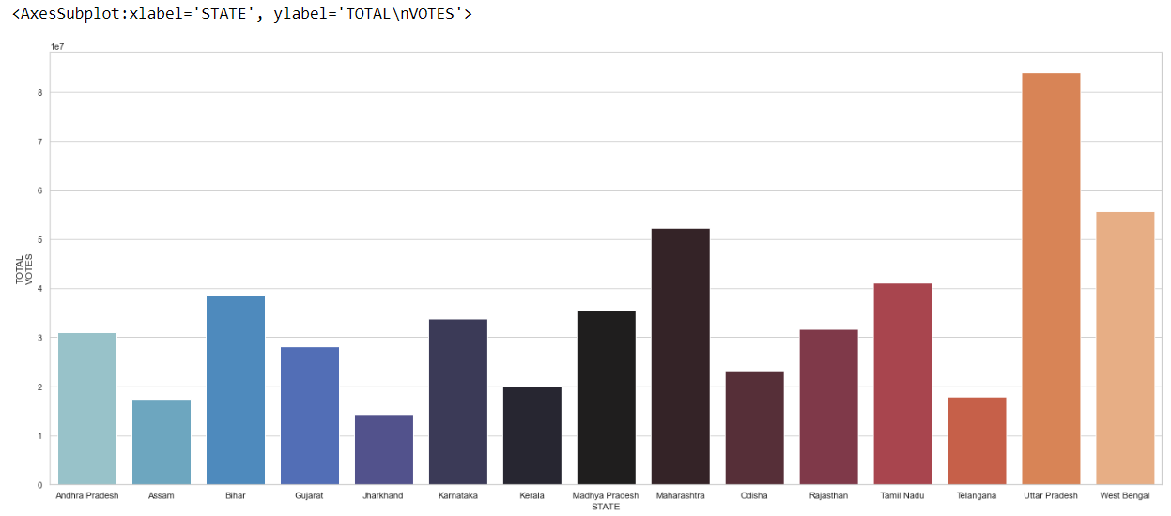
Bar plot of state vs. votes
The bar plot makes it evident that the total number of votes in Maharashtra, Uttar Pradesh, and West Bengal is significantly higher than in other states of India. Additionally, Uttar Pradesh holds the top spot in terms of the total number of votes.

Slide 16
Conclusion of Analysis
The analysis indicates that Indian citizens are highly knowledgeable about the voting system and political parties.
The BJP party is participated more than the other parties in Lok Sabha 2019
The data makes it evident that Maharashtra, Uttar Pradesh, and West Bengal have significantly higher total votes than the remaining states, with Uttar Pradesh holding the top spot in terms of the total number of votes.
The number of female candidates is very less than the number of male candidates
Kerala has the highest number of candidates with a criminal history, followed by West Bengal, Uttar Pradesh, and Telangana. One person from Kerala committed the highest number of criminal cases, totaling 240
The maximum criminal history among candidates is observed at the ages of 49, 37, and 51.

Slide 17
Data Pre-processing
Data preprocessing is an essential step in the data mining and analysis process that converts raw data into a structured format that can be processed and analyzed by computers and machine learning algorithms.
Find null values using isnull() method
Then check the data –types of dataset

Slide 18
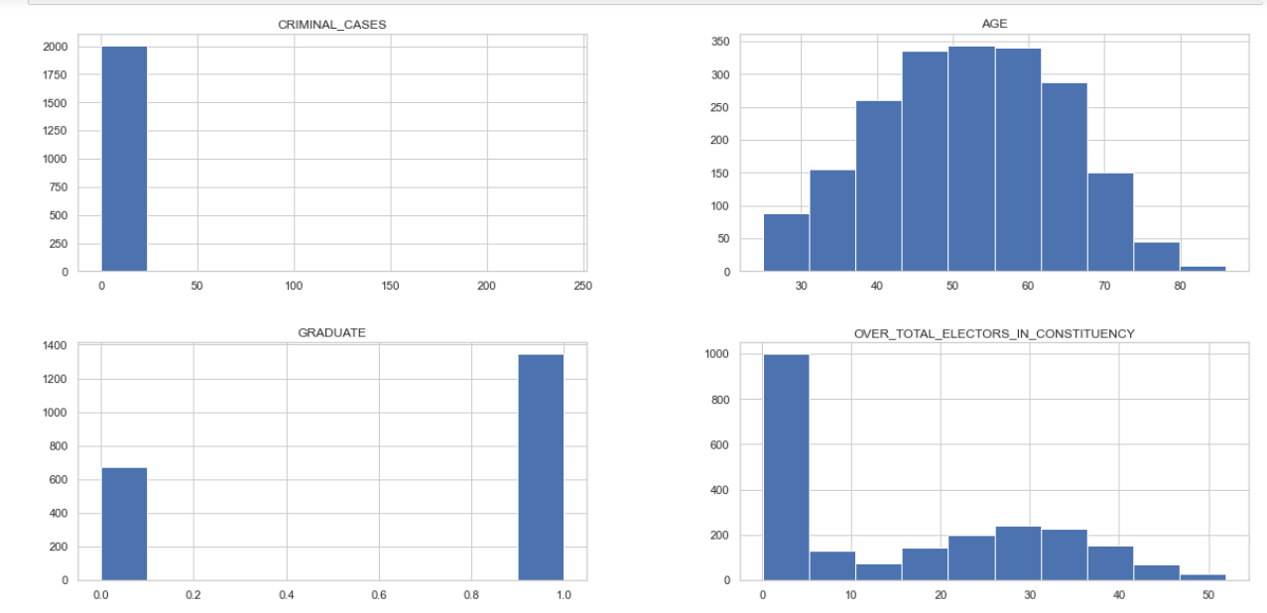
Plotting according to parameters

Slide 19
Evaluate the columns to check for missing values.
Fill missing values with corresponding median
Fillna() method is used to fill all the missing values at once
Dropna() method is used to drop all the null vales

Slide 20
FEATURE SELECTION AND FEATURE ENGINEERING
Feature engineering involves the selection and transformation of variables or features in a dataset when building a predictive machine learning model. Prior to training the data in machine learning algorithms, it is necessary to extract features from the raw dataset.
Feature selection involves selecting the most important independent features that have a strong correlation with the dependent variable, in order to build an effective model.

Slide 21
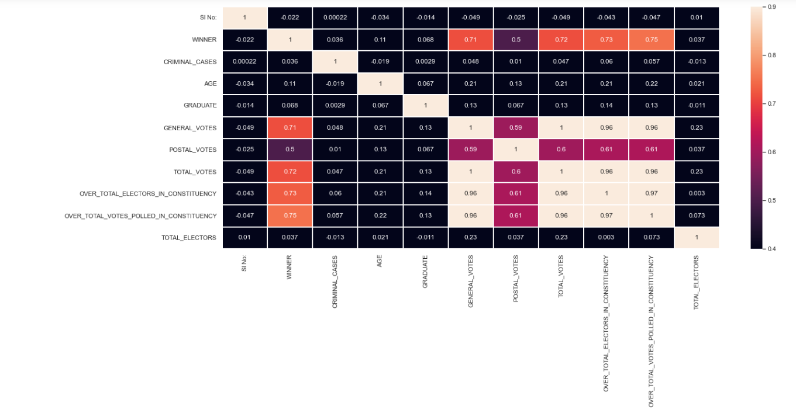
Correlation Matrix
A correlation matrix is a table that shows the correlation coefficients between different variables, summarizing the relationship between all possible pairs of values in a dataset. It is a useful tool for identifying and visualizing patterns in large datasets.
A correlation matrix is a table that shows variables in rows and columns, with each cell containing the correlation coefficient.

Slide 22
Feature Reduction and Label Encoding
Feature reduction or dimensionality reduction is the process of reducing the number of features in a computation while retaining essential information. By reducing the number of variables, the computation becomes less resource-intensive and faster. Feature reduction comprises two processes, namely feature selection and feature extraction.
Label Encoding: The process of converting labels into a numeric form for better readability by machine learning algorithms is called label encoding. This enables algorithms to operate on labels in a more effective way, and is a crucial pre-processing step for structured datasets in supervised learning.

Slide 23
Replacing certain values and splitting dataset
Replace 'Nil','`','Not Available‘ with ‘0’
Splitting data set into X and Y
y=data['WINNER']
x=data.drop('WINNER',axis=1)
After that feature scaling is performed by using StandardScaler()

Slide 24
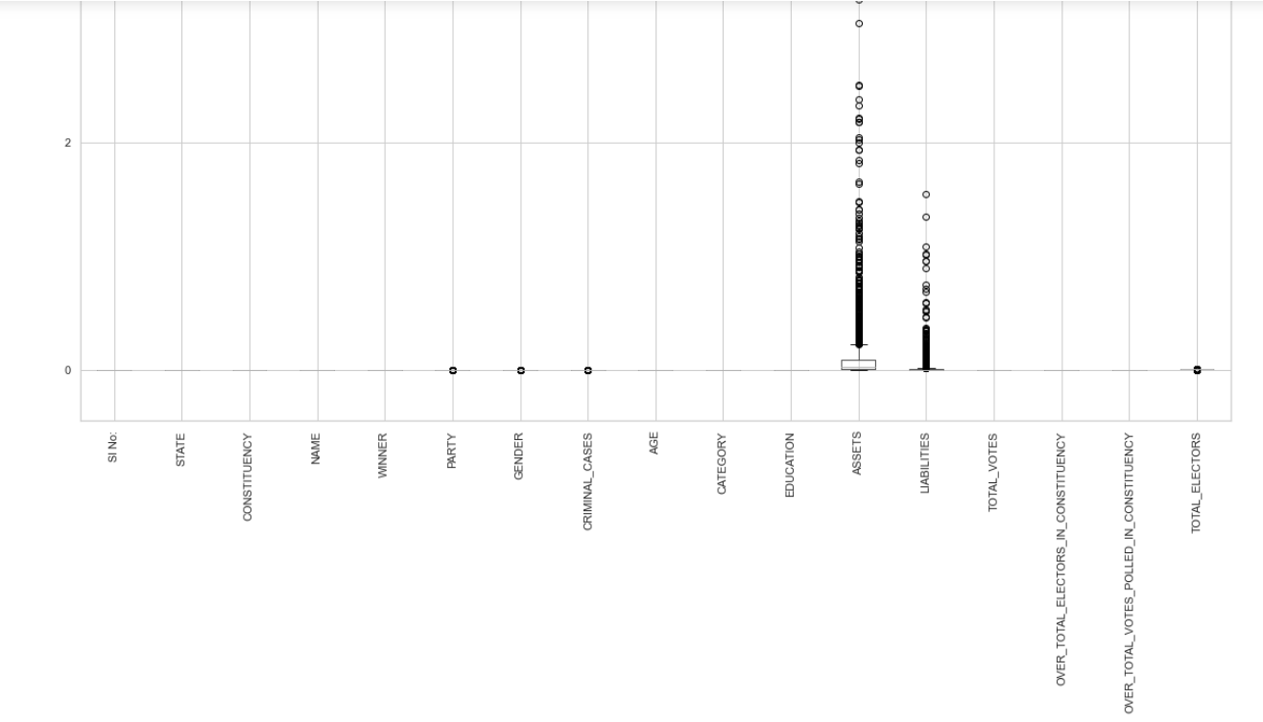
Detecting Outliers by using Box-Plot

Slide 25
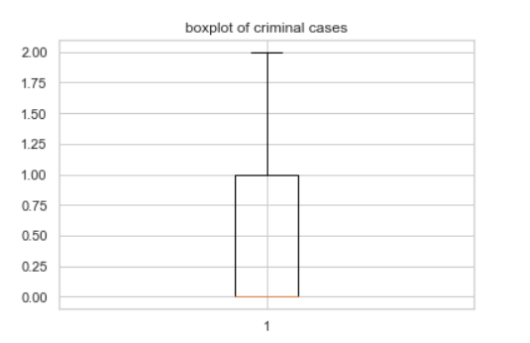
Eliminating outliers by finding IQR
Find IQR of criminal cases
Remove outlier below -1.5 and above 2.5
Finding the index numbers of the outliers
Dropping outliers
Similarly done for
Assets and liabilities

Slide 26
Predictive Models
Predictive modeling involves using historical data and statistical algorithms to generate a model that can predict future outcomes. It is a key component of predictive analytics, a data mining method that aims to answer the question of "what is likely to happen in the future?“
We have to predict ‘Winner’ in the election dataset , for that we need to split the data set into x and y
Drop ‘winner’ from x and set y as ‘winner’

Slide 27

Logistic Regression
Logistic regression is a widely used Supervised Learning algorithm that predicts categorical dependent variables based on independent variables.
Logistic regression predicts categorical outputs, such as Yes/No, True/False, 0/1, etc., without providing the exact numeric values., it gives the probabilistic values which lie between 0 and 1.
With 22 mis-classification

Slide 28
(KNN)K-Nearest Neighbour
K-Nearest Neighbor is a simple Supervised Learning algorithm in Machine Learning.
The K-NN algorithm categorizes new data based on their similarity to available cases, assigning them to the most similar category.
The K-NN algorithm stores all available data and uses similarity to classify new data points into appropriate categories. As a result, newly arrived data can be efficiently categorized using the K-NN algorithm.
K-NN algorithm can be used for Regression as well as for Classification but mostly it is used for the Classification problems.
K-NN is a non-parametric algorithm
KNN algorithm at the training phase just stores the dataset and when it gets new data, then it classifies that data into a category that is much similar to the new data.
K-NN algorithm is also known as a "lazy learner" because it does not learn from the training set immediately; instead, it stores the dataset and performs classification when necessary.

Slide 29
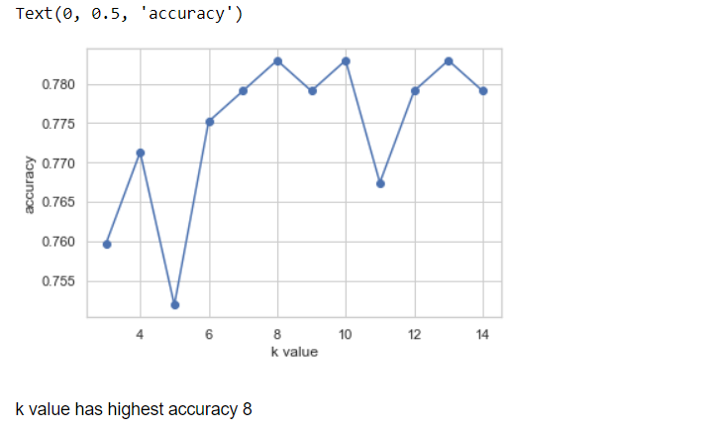
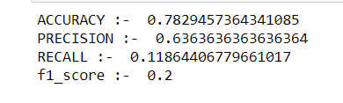
Plotting line graph and using KNN classifier

Slide 30
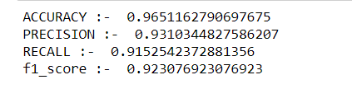
Using StandardScaler
After applying standardscaler, again perform logistic regression
We got only 9 mis-classification
Standard scaling increased modelling

Slide 31
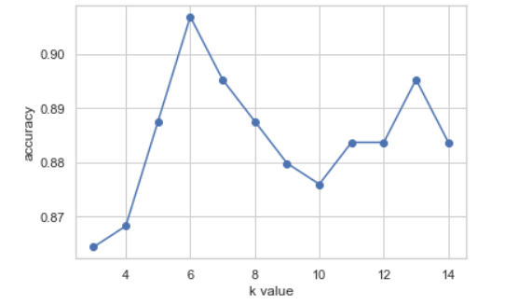

Again performing KNN
Highest accuracy is at 6
accuracy has increased There are 24 mis-classification

Slide 32
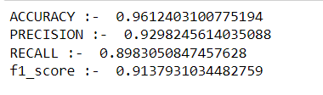
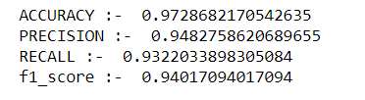
Decision Tree and Random Forest classifier
By using decision tree classifier accuracy rate is increased and
Now there are 11 mis-classification
By using decision tree classifier accuracy increased .
Now there are only 7 mis-classification

Slide 33
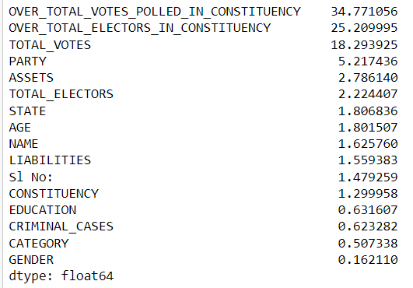
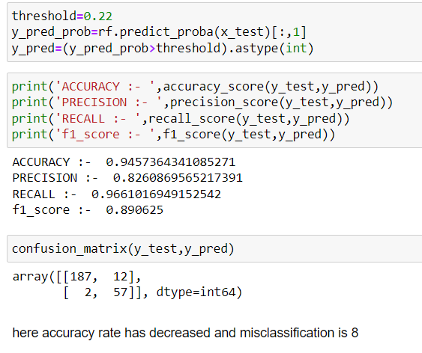
Feature Importance and distribution of prediction probability
Feature importance techniques assign scores to input features of a predictive model, indicating the relative significance of each feature in making predictions.

Slide 34
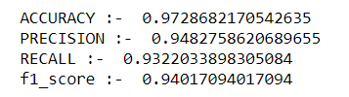
Fine Tuning of Hyper-parameters
Random Forest classifier is used for fine tuning parameters
Accuracy rate = 97 % with 7 mis-classification

Slide 35
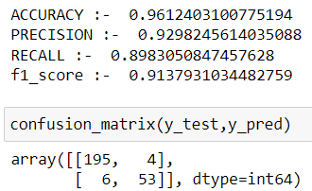
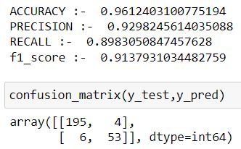
Gradient Boosting and Hyper Parametric Tuning
Gradient boosting classifiers use multiple weak learning models combined to create a strong predictive model, typically employing decision trees. They are popular due to their effectiveness in classifying complex datasets.
GridSearchCV evaluates machine learning models for a range of hyperparameter values,
searching for the best set of hyperparameters from a grid of hyperparameter values.
Accuracy has increased to 96 with 9 mis-classification.
A random forest regressor is a meta-estimator that fits several decision trees
to classify various sub-samples of a dataset, improving predictive accuracy and mitigating overfitting by averaging the results.
RandomizedSearchCV implements a “fit” and a “score” method. It also implements “score_samples”, “predict”, “predict_proba”, “decision_function”, “transform” and “inverse_transform” if they are implemented in the estimator used.
The parameters of the estimator used to apply these methods are optimized by cross-validated search over parameter settings.
Cross-validation is a valuable technique for evaluating model effectiveness and mitigating overfitting. With cross-validation, there's no need to call the fit method separately; the cross_val_score method fits the data and performs cross-validation on the data simultaneously.

Slide 36
Thank You

